Slide 1
Objective 6
Structuring programs

Slide 2
ILO’s
Learning outcomes
Be able to decompose problems into subroutines and call them and know why this is a good idea.
Be able to perform integer division, including the use of remainders.

Slide 3
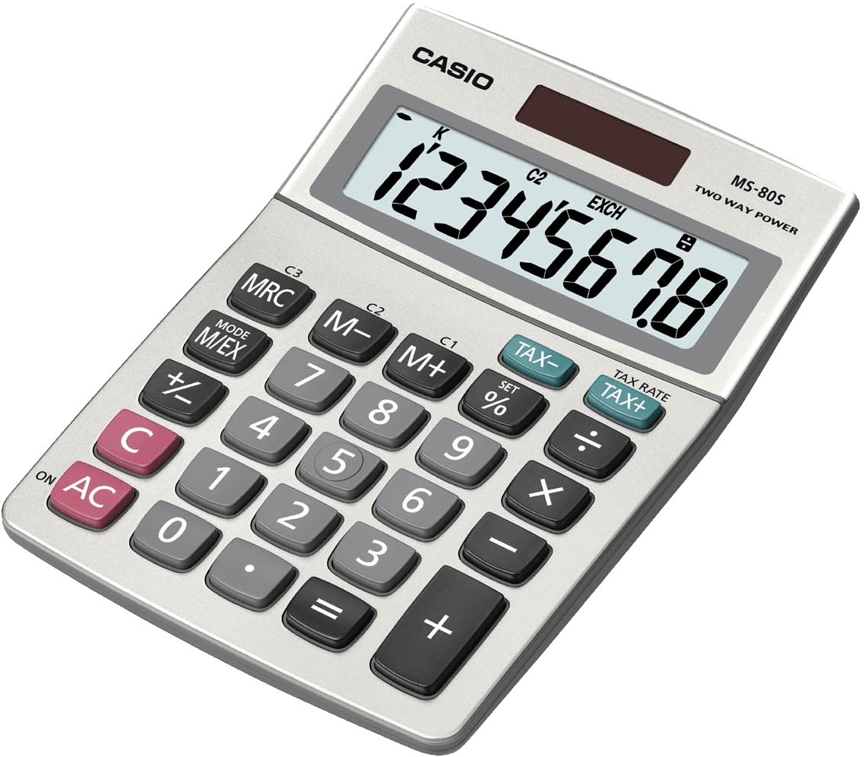
Decomposition
Breaking down a complex problem into smaller, manageable, parts
Make it easier to solve
Each smaller problem can be examined in more detail
Examples of decomposition are:
Brushing our teeth
Police managing crime scenes
We can break-up our programs into sub routines, using functions
Let’s try this by generating a few calculators:
Standard numerical calculator
Incorporate float (/) and floor (//) division
Generate a function for each operator:
Division
Integer division
Multiplication
Addition
Subtraction
Shape area/perimeter calculator

